Slide 1
How to deal with Factors in R

Slide 2
Factors in Base R
Factors are used to represent categorical data.
Ordered
Unordered
Factors are stored as integers, and have labels associated with these unique integers.
They look like strings but be careful when treating them like strings.
Factors can only contain a pre-defined set values, known as levels. By default, R always sorts levels in alphabetical order.

Slide 3
Factors in base R: functions
factor() turns a string variable in a factor
Example:
sex <- factor(c("male", "female", "female", "male"))
R assignments are alphabetical, thus:
“female” as 1
“male” as 2
levels() shows you the levels and their order
nlevels() shows the number of levels

Slide 4
Control your levels
The default of alphabetical levels is often not helpful
With the function factor() set the levels with their order using the argument levels
food <- factor(food, levels = c("low", "medium", "high"))

Slide 5
Preventing problems with factors
read.table or read.csv
use the argument stringsAsFactors = FALSE to prevent strings being turned into factors
Then explicitly define the factors you need

Slide 6
And the Tidyverse?
The tidyverse package forcats allows for easy setting of levels and easy ordering of levels

Slide 7
Set levels in the order they appear
x1 <- c("Dec", "Apr", "Jan", "Mar")
f2 <- x1 %>%
factor() %>%
fct_inorder()

Slide 8
TV hours by religion
relig_summary <- gss_cat %>%
group_by(relig) %>%
summarise(
age = mean(age, na.rm = TRUE),
tvhours = mean(tvhours, na.rm = TRUE),
n = n()
)
ggplot(relig_summary, aes(tvhours, relig)) + geom_point()

Slide 9
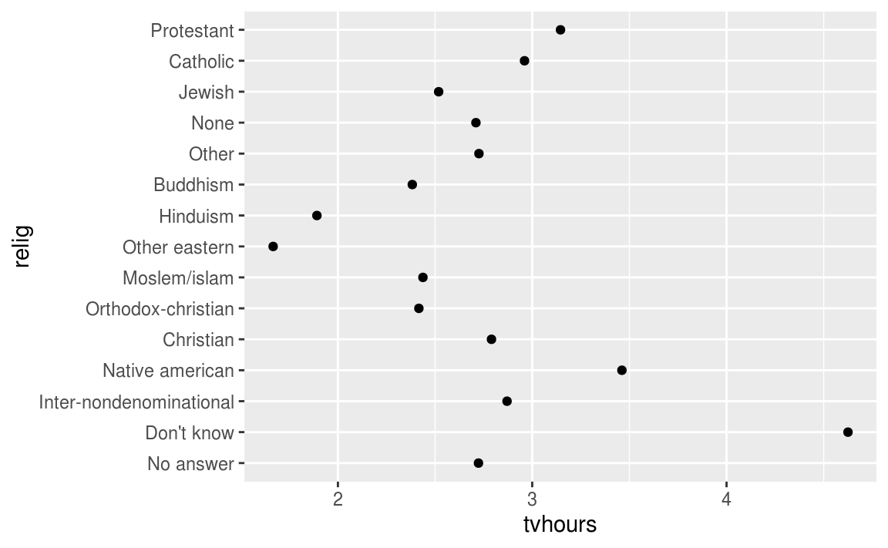

Slide 10
Order the plot: fct_reorder
relig_summary %>%
mutate(relig = fct_reorder(relig, tvhours)) %>%
ggplot(aes(tvhours, relig)) +
geom_point()
)

Slide 11
